Slide 1

Test Levels and Test Types
Functional and Non-Functional testing
QA
Fundamentals
SoftUni Team
Technical Trainers
Software University
http://softuni.bg

Slide 2
Table of Contents
Test Levels
Component Testing
Integration Testing
System Testing
Acceptance Testing

Slide 3
Table of Contents (2)
Test Types
Structural testing
Change related testing
Risk-Based Testing
Functional Testing
Non-functional Testing

Slide 4
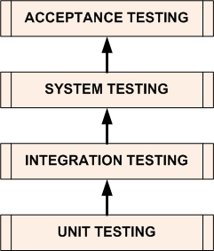
Test Levels

Slide 5

Component Testing
Component testing:
Testing separate components/units of the software
Software units (components):
Modules, units, programs, functions
Classes – in Object Oriented Programming
Unit tests focus on aspects internal to
the component itself

Slide 6
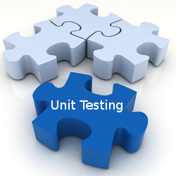
Component Testing (2)
Individual testing
Components are tested individually
Isolated from all other software components
Isolation
Prevents external influences on the components
Interaction with neighbors is not performed

Slide 7
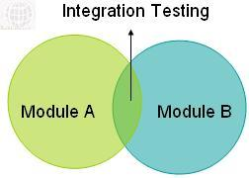
Integration Testing
Supposes that components are already tested individually
System integration testing:
Testing the integration of systems and packages
Testing interfaces to external organizations/3rd parties
Expose defects in the interfaces and interaction between
integrated components

Slide 8
Integration Testing Approaches
The Big Bang approach
All components or modules are integrated simultaneously, after which everything is tested as a whole.
Disadvantage: difficult to trace the cause of failures

Slide 9
Integration Testing Approaches (2)
The Incremental approach
All components are integrated one by one and a testing is carried out after each step.
Different Incremental approaches:
The Top-Down approach
The high level logic and flows are tested first - the low level components are tested last.
The Bottom-Up approach
The most complex / high level functionalities are tested last.

Slide 10

System Testing
In System testing the behavior of the whole system/product is
tested as defined by the specification requirements.
Is a higher level testing than the Unit and Integration testing.
Test the system from the perspective of the end user / customer.
Performed by testers.

Slide 11
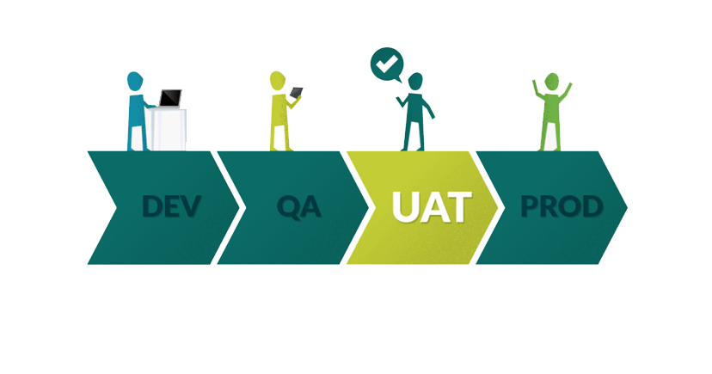
Acceptance Testing
Also known as User Acceptance Testing (UAT).
The End user / Customer is actually involved in the testing.
Performed on a production like environment.

Slide 12
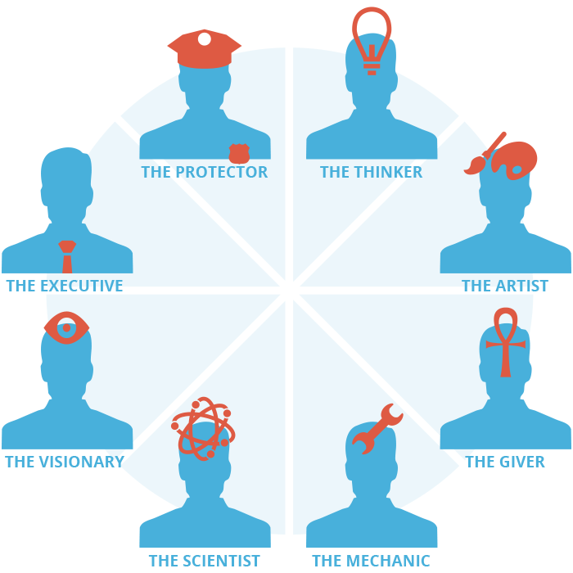
Test Types

Slide 13
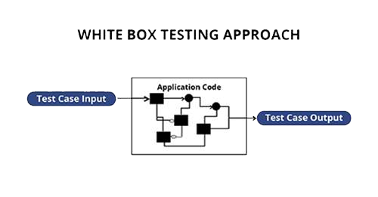
Structural Testing
Often referred to as ‘white-box’ or ‘glass-box’ testing
Uses information about the internal code structure or
architecture
Tools can be used to measure the code coverage of elements,
such as Statements or Decisions / Branches

Slide 14

Testing Related to Changes
Re-testing:
After a bug has been detected and fixed, the software should be re-tested.
To confirm that the original defect has been successfully removed after applying the fix.
Also known as Confirmation testing.

Slide 15
Testing Related to Changes (2)
Regression Testing:
Performed after modifications of the code.
Testing for newly introduced faults as a result of the changes made to the system.
May be performed at all test levels.
The reason for Regression testing is that changed or new code might affect untouched functionalities.
Testing only code, that is changed, is not enough!

Slide 16
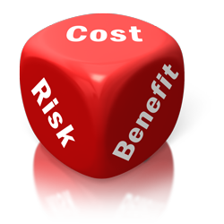
Risk-Based Testing
Prioritization Of Tests Based On Risk And Cost
Two main types of risk:
Product (quality) risks - The primary effect of a potential problem is on the product quality.
Project (planning) risks - The primary effect is on the project success.

Slide 17
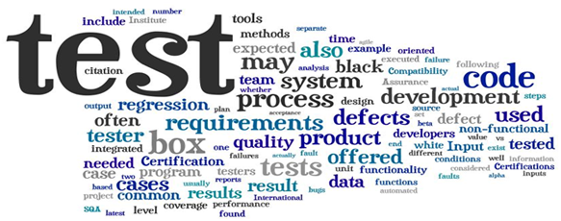
Functional Testing
Functional testing verifies the system's input–output behavior.
Black box testing methods are used.
The test cases are based on the functional requirements.
The main goal is to exercise the functionality and verify the expected behavior.
https://i.imgur.com/EnMOiqq.png

Slide 18
Smoke Testing
Performed after software build to ascertain that the critical functionalities of the program is working fine
Executed before any detailed functional or regression tests
Reject a badly broken application
Cover the most important functionality or component of the system

Slide 19
Sanity Testing
Performed after receiving a software build, with minor changes in code
Ascertain that the bugs have been fixed and no further issues are introduced due to these changes
Proposed functionality works roughly as expected
If your scientific calculator gives the result of 2 + 2 =5! No point testing the advanced functionalities like sin 30 + cos 50

Slide 20
Smoke vs. Sanity
Verify the stability
Performed by the developers or testers
Usually documented
Subset of Acceptance testing
Exercises the entire system
Verify the rationality
Performed by testers
Usually not documented
Subset of Regression Testing
Exercises only the particular component

Slide 21

Non-Functional Testing

Slide 22

Non-Functional Testing
Testing Non-functional Software Characteristics.
“How well" the system should carry out its functions.
Non-functional characteristics:
Reliability
Usability
Accessibility
Efficiency
Security
etc.

Slide 23
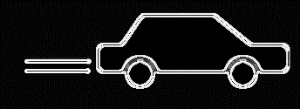


Performance, Load and Stress Testing
Performance testing
Load Testing
Stress Testing
23

Slide 24
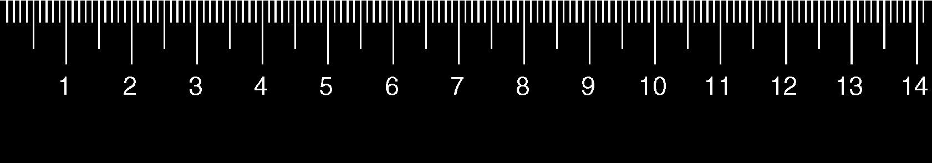
Performance, Load and Stress Testing
What can we learn from the different test types?
Performance / Load / Stress tests help us determine or validate the speed, scalability and stability of the system.

Slide 25



Performance, Load and Stress Testing
The difference lies in the questions the different test types are supposed to answer
Performance Testing – How fast is the system?
Load Testing – How much load can the system handle?
Stress Testing – Under what conditions will the system fail?

Slide 26
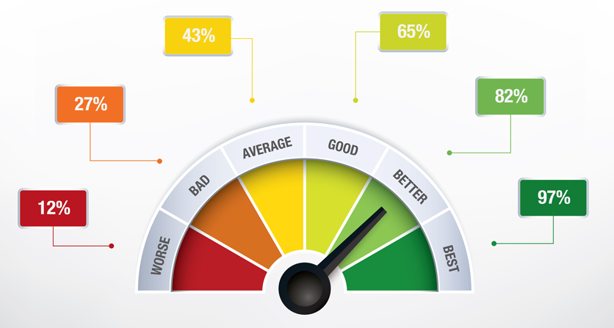
Goals of Performance Testing
The goal of performance testing is to:
Determine compliance with performance goals and requirements
Establish a baseline for future regression testing
Eliminate bottlenecks

Slide 27
Goals of Load Testing
Load Testing aims to identify the need of improving the applications:
Performance
Do we need to reduce the time needed to execute a request ?
Scalability
Can the system handle the anticipated number of concurrent users during peak load in production?
Stability
Does the application suffer from memory leaks when under load for extended periods of time?

Slide 28
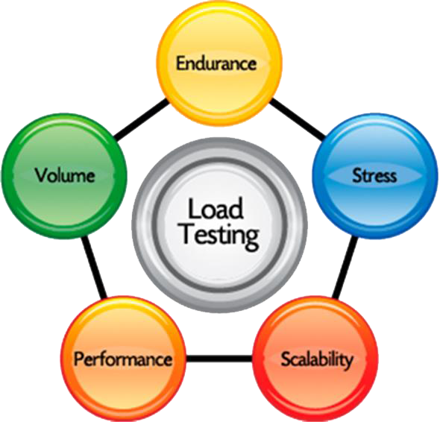
Load Testing Metrics
The best source of information during load tests are:
Average Response times
Peak Response times
Error Rates
Requests per second
Concurrent Users Count

Slide 29
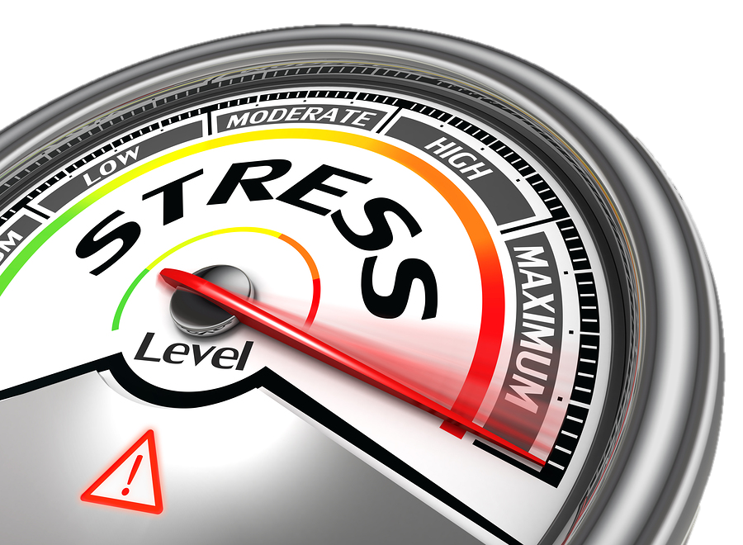

Goals of Stress Testing
The goals of Stress testing is to ensure the software does not crash in conditions of insufficient computational resources (such as memory or disk space).
It involves testing beyond normal operational capacity, often to a breaking point, in order to observe the results.

Slide 30

How useful is Stress/Load/Performance Testing ?
For most projects verifying that they pass Google's performance guidelines is enough
You can check this with Google PageSpeed Tools

Slide 31

Security Vulnerability Testing

Slide 32
Security Testing in the SDLC
Software Development Life Cycle, With Security In Mind
External review
Static
analysis (tools)
Security requirements
Penetration testing
Abuse
cases
Risk
analysis
Risk-based security tests
Risk
analysis
Security breaks
Requirements
and use cases
Test plans
Test results
Field feedback
Design
Code
32

Slide 33
Security Testing Techniques
Penetration Testing
Simulating an attack from a malicious source
Includes network scanning and vulnerability scanning
Simulating an attack from someone familiar with the system
Simulate an attack by having access to source code, network, passwords

Slide 34

Threats you need to be aware of
SQL Injection
Exploits Database Layer Security Vulnerability
Unexpected Execution of User Inputs

Slide 35
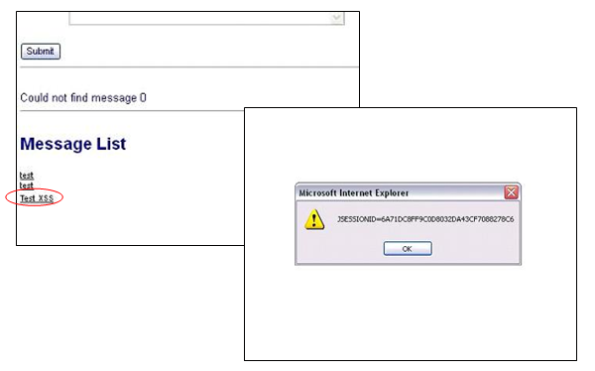
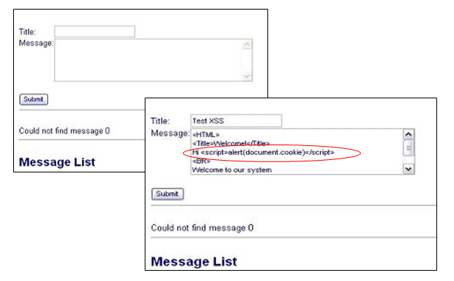
Threats you need to be aware of
Cross Site Scripting
Injecting Malicious Client Side Script into Web Pages The malicious code along with the original webpage gets displayed in the web client

Slide 36

Threats you need to be aware of
Parameter Manipulation
Cookie Manipulation
URL Manipulation
HTTP Header Manipulation

Slide 37
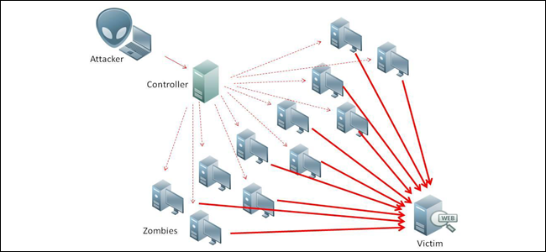
Threats you need to be aware of
Denial of Service Testing
Flooding a target machine with enough traffic to hinder normal operations

Slide 38

Threats you need to be aware of
Password Cracking
Collecting Passwords from the Stored or Transmitted Data
Using Brute Force and Dictionary Attacks
Identifying Weak Passwords

Slide 39

Threats you need to be aware of
Social Engineering
Psychological Manipulation of People
Extracting confidential information

Slide 40

Summary
…
…
…
Test Levels
Test Types
Functional and Non-functional testing
Don’t forget the non-functional aspects of your application under test
The more people you get involved into the security of a product the more secure it becomes.

Slide 42
Diamond Partners

Slide 43
Diamond Partners

Slide 44





Trainings @ Software University (SoftUni)
Software University – High-Quality Education, Profession and Job for Software Developers
softuni.bg
Software University Foundation
http://softuni.foundation/
Software University @ Facebook
facebook.com/SoftwareUniversity
Software University Forums
forum.softuni.bg

Slide 45

License
This course (slides, examples, demos, videos, homework, etc.) is licensed under the "Creative Commons Attribution-NonCommercial-ShareAlike 4.0 International" license

